Slide 1
Time-Based Analytics
Team Fred (c624decb46fa3d60e824389311b252f6)
Sponsor: rakesh.kumar.4@credit-suisse.com
Team Members: Brian Hong, Jasmine Tang, Casey He

Slide 2

Problem
Large Datasets
Fast Analytics
Notes:
Collection, stroage, retrieval, analyzing in real time

Slide 3

Why Fast?

Slide 4

Marketdb
DB
Database written in C
3 Directories
By-date
By-ticker
Unsorted
Linux EXT4 File Structure
Bin: ticker_day_time
Data: microsecond/price
date
ticker
unsrt
Bins

Slide 5
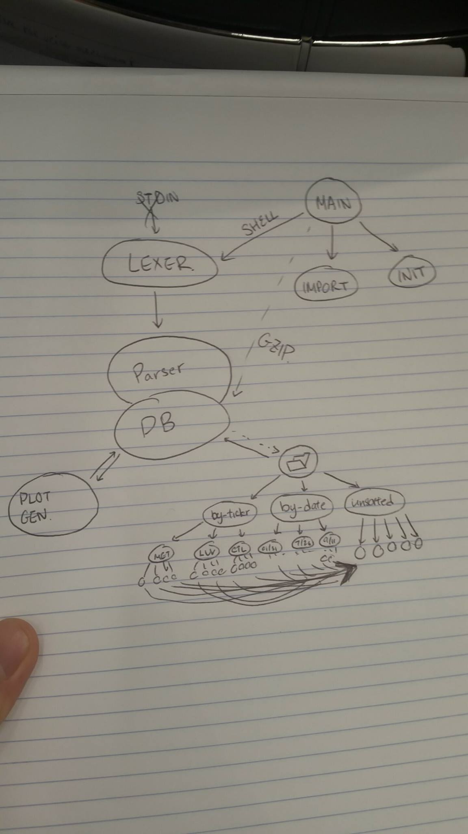

Slide 6
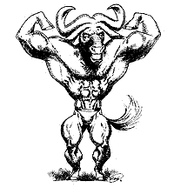
Parser/ Query Language
SQL-like query language
Unix C-Based utilities
Flex – Fast Lexical Analyser Generator
GNU Bison – Parser Generator
Select – retrieve data from database

Slide 7
Scalability/ Feasibility
User can keep track of multiple databases through our implementation
Options for Time/ Ticker Tracking
Data optimized for Expansive Storage
Why Linux?

Slide 8
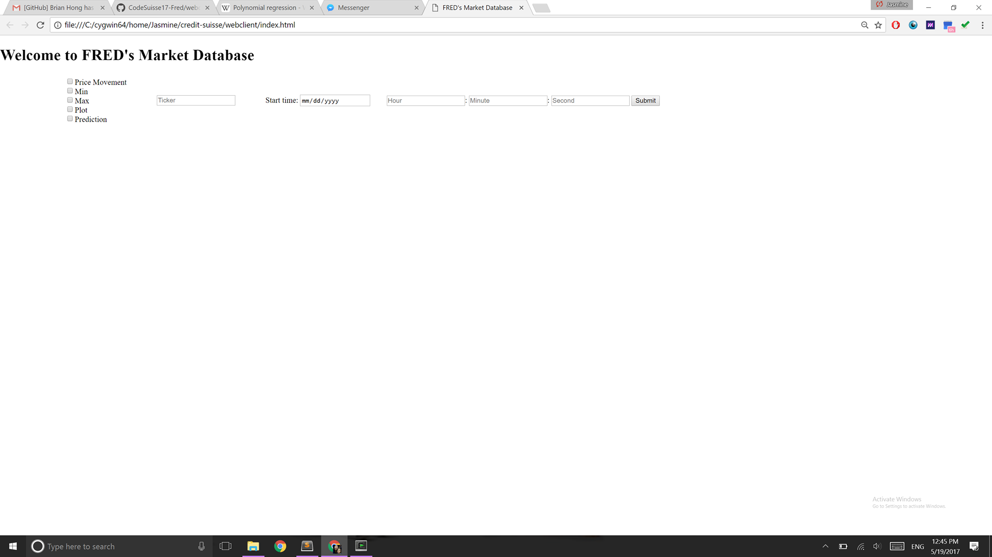
UI

Slide 9
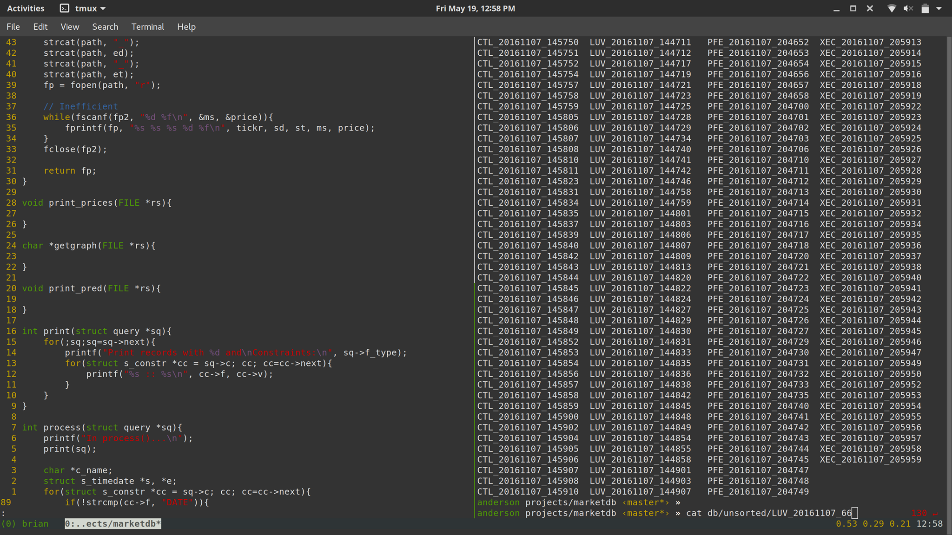
Level 1 & 2 – Price Movement
Sample Parser Code

Slide 10
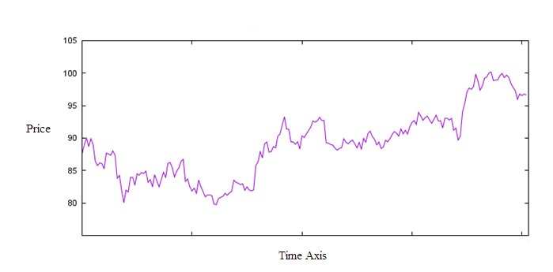
Level 3
GNUplot portable command-line driven graphing utility for Linux
Quick visualization computing
Sample GNUplot Graph

Slide 11

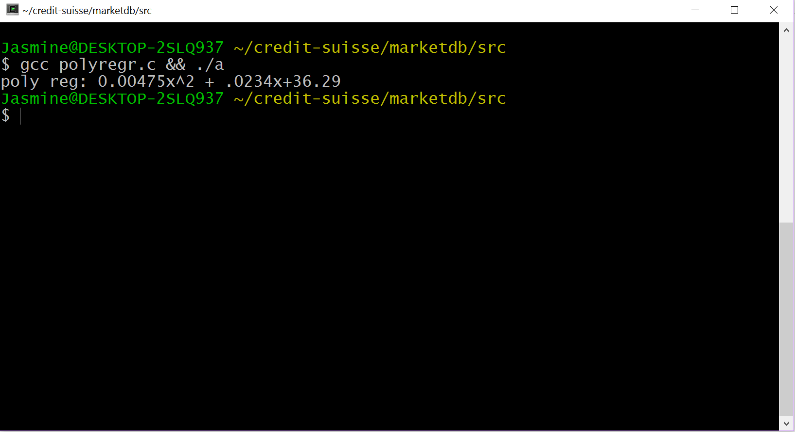
Level 4
Polynomial Regression

Slide 12
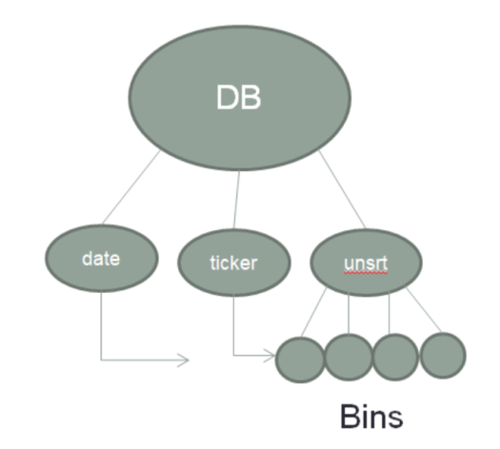
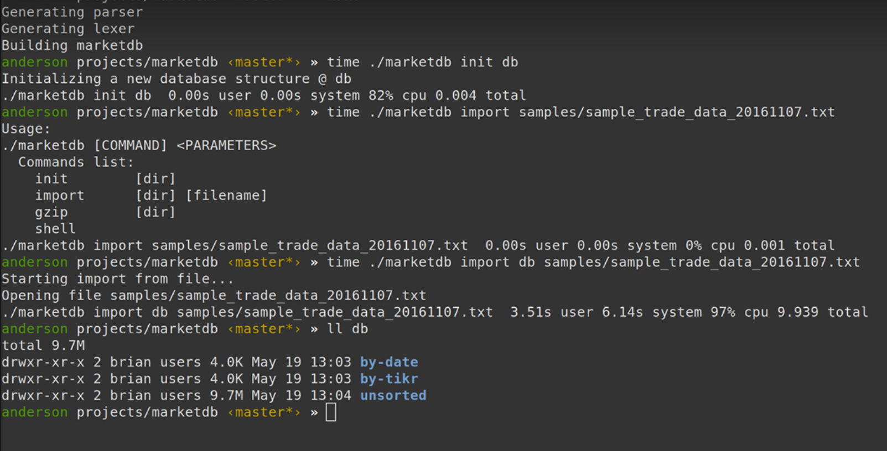
Level 5
Linux Time Command

